Slide 1
Get Started With Serenity BDD

Slide 2

About me
Ioan Solderea
Lead QA
10+ years experience
Web, API, Automation
Tester by day
Coder, Youtuber, Trainer by night

Slide 3
What we will cover
What is Serenity BDD
How to run tests in Serenity
How is Serenity Structured
How to add new tests in Serenity
How to view test results (reporting)

Slide 4
What is Serenity BDD
By the end of this section we will learn
Why do you need an automation Framework
What are some of the features of a good automation framework
What does Serenity offer as an automation framework

Slide 5
Why do you need an automation Framework?
Process of writing automated test
Low code solutions – Selenium IDE, UTF
Write your first script
Have your test pass/fail
Add reporting
Add to some automatic build Systems
Takes time, hard to do for beginners, it can become frustrating

Slide 6
What are some of the features of a good automation framework
Survey
https://freeonlinesurveys.com/s/QMjojv0V#/0

Slide 7
What does Serenity offer as an automation framework
Serenity BDD is an open-source library that aims to make the idea of living documentation a reality.
Serenity BDD helps you write cleaner and more maintainable automated acceptance and regression tests faster.
Serenity offers narrative reports that document and describe what your application does and how it works.
Serenity tells you not only what tests have been executed, but more importantly, what requirements have been tested
Serenity BDD is that you do not have to invest time in building and maintaining your own automation framework.

Slide 8
How to run tests in Serenity BDD
By the end of this section we will see
How to setup Serenity BDD
How to run a Serenity BDD test

Slide 9
How to setup Serenity BDD
Prerequisites
Java 8
java -version
An Integrated Development Environment
intellij
A Build Tool
Maven – mvn -v

Slide 10
How to setup Serenity BDD
Github
https://github.com/serenity-bdd
Maven
mvn archetype:generate -Dfilter=serenity

Slide 11
How to run a Serenity BDD test
Run with the below command
mvn clean verify
Run only a specific Tag
mvn clean verify -Dtags="@MOT"

Slide 12
How to run a Serenity BDD test
Run and post what you see
Test output
Test report
https://miro.com/app/board/o9J_lwt4NTw=/

Slide 13
How is Serenity Structured
By the end of this section we will learn
What are are the main layers of Serenity BDD
What parts of the Serenity Framework handles
Locators
Drivers
Asserting
Tests
Reporting

Slide 14
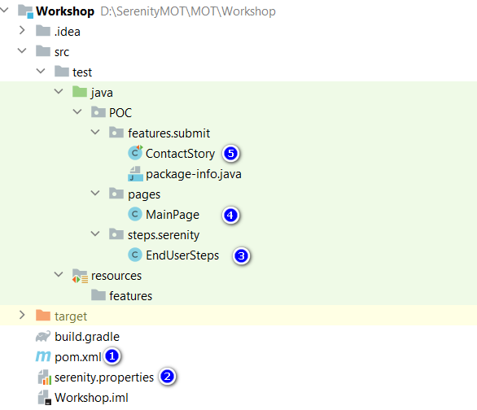
What are are the main layers of Serenity BDD
1 – pom xml
2 – properties file
3 – Steps
4 – Page Objects
5 - Tests

Slide 15
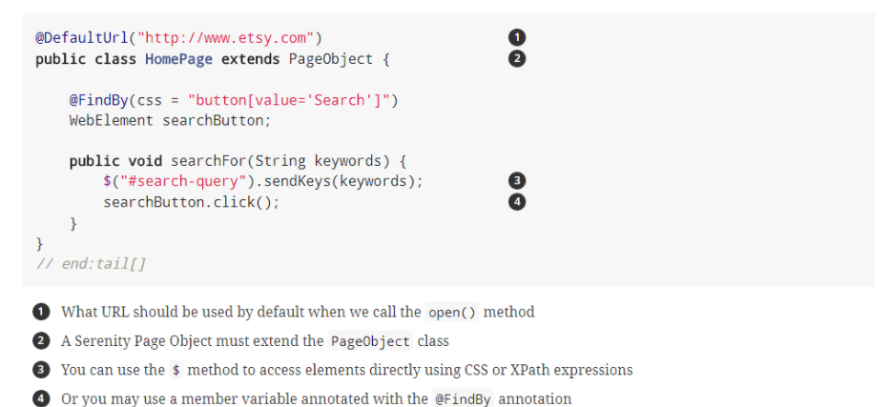
What parts of the Serenity Framework handles
Page Objects

Slide 16
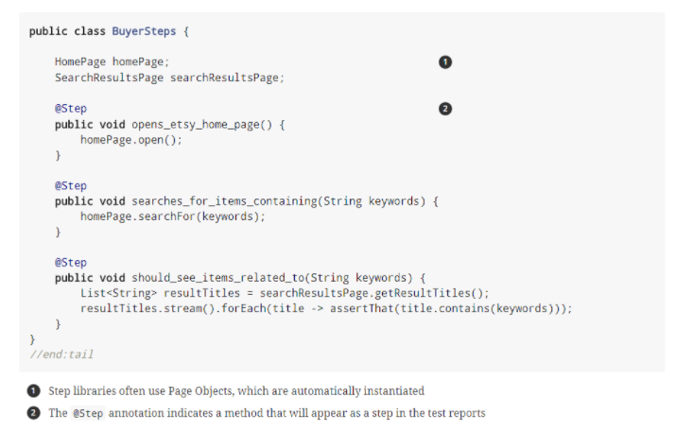
What parts of the Serenity Framework handles
Steps

Slide 17
What parts of the Serenity Framework handles
Tests

Slide 18
What parts of the Serenity Framework handles
https://freeonlinesurveys.com/r/SZ2imSFe

Slide 19
Design and run a Serenity BDD test
By the end of this section we will learn
Add a Page
Add a Test
Make an Assertion
View Report

Slide 20
Design and run a Serenity BDD test
Create the test cases
Test output
Test report
https://miro.com/app/board/o9J_lwt4NTw=/

Slide 21
What we saw
What is Serenity BDD
How to run tests in Serenity
How is Serenity Structured
How to add new tests in Serenity
How to view test results (reporting)

Slide 22


